Slide 1
RETAIL ANALYTICS – Learner ID: 24CRDO5100
Black Friday Sales Analysis
Stakeholder Review — From Raw Data to Strategic Recommendations
Prepared by Arijit · Career247 Data Analytics with GenAI Capstone

Slide 2
AGENDA
Today's Walkthrough
01
Business Context
02
Data Foundation
Why this project, and what leadership asked for
From CSV to a validated, constrained SQL model
03
Exploratory Analysis
04
Statistical Validation
Outliers, category & city contribution, demographics
Hypothesis testing on key business assumptions
05
Customer Segmentation
06
Live Dashboard
Value tiers and behavioral drivers of spend
Power BI — executive, marketing & product views
07
Key Insights
08
Recommendations
The five findings that matter most
Three actions, backed by metrics
BLACK FRIDAY SALES ANALYSIS — STAKEHOLDER REVIEW
02

Slide 3

BUSINESS CONTEXT
Why This Project
Black Friday drives peak transaction volume across physical and online channels, millions of customers, thousands of products, one high-pressure sales window. Our organization captured a full transaction extract from a major Black Friday campaign, and leadership asked four questions:
OUR MANDATE
Which customer segments contribute the most — and which are underpenetrated?
How do demographics influence purchase size and category mix?
Which product categories dominate, and where can we cross-sell?
How do we retain high-value customers beyond Black Friday?
Turn 550,068 transactions into a validated, defensible strategy
Every number in this deck is traceable to a SQL query, a Python computation, or a live dashboard filter — not an assumption.
BLACK FRIDAY SALES ANALYSIS — STAKEHOLDER REVIEW
03

Slide 4
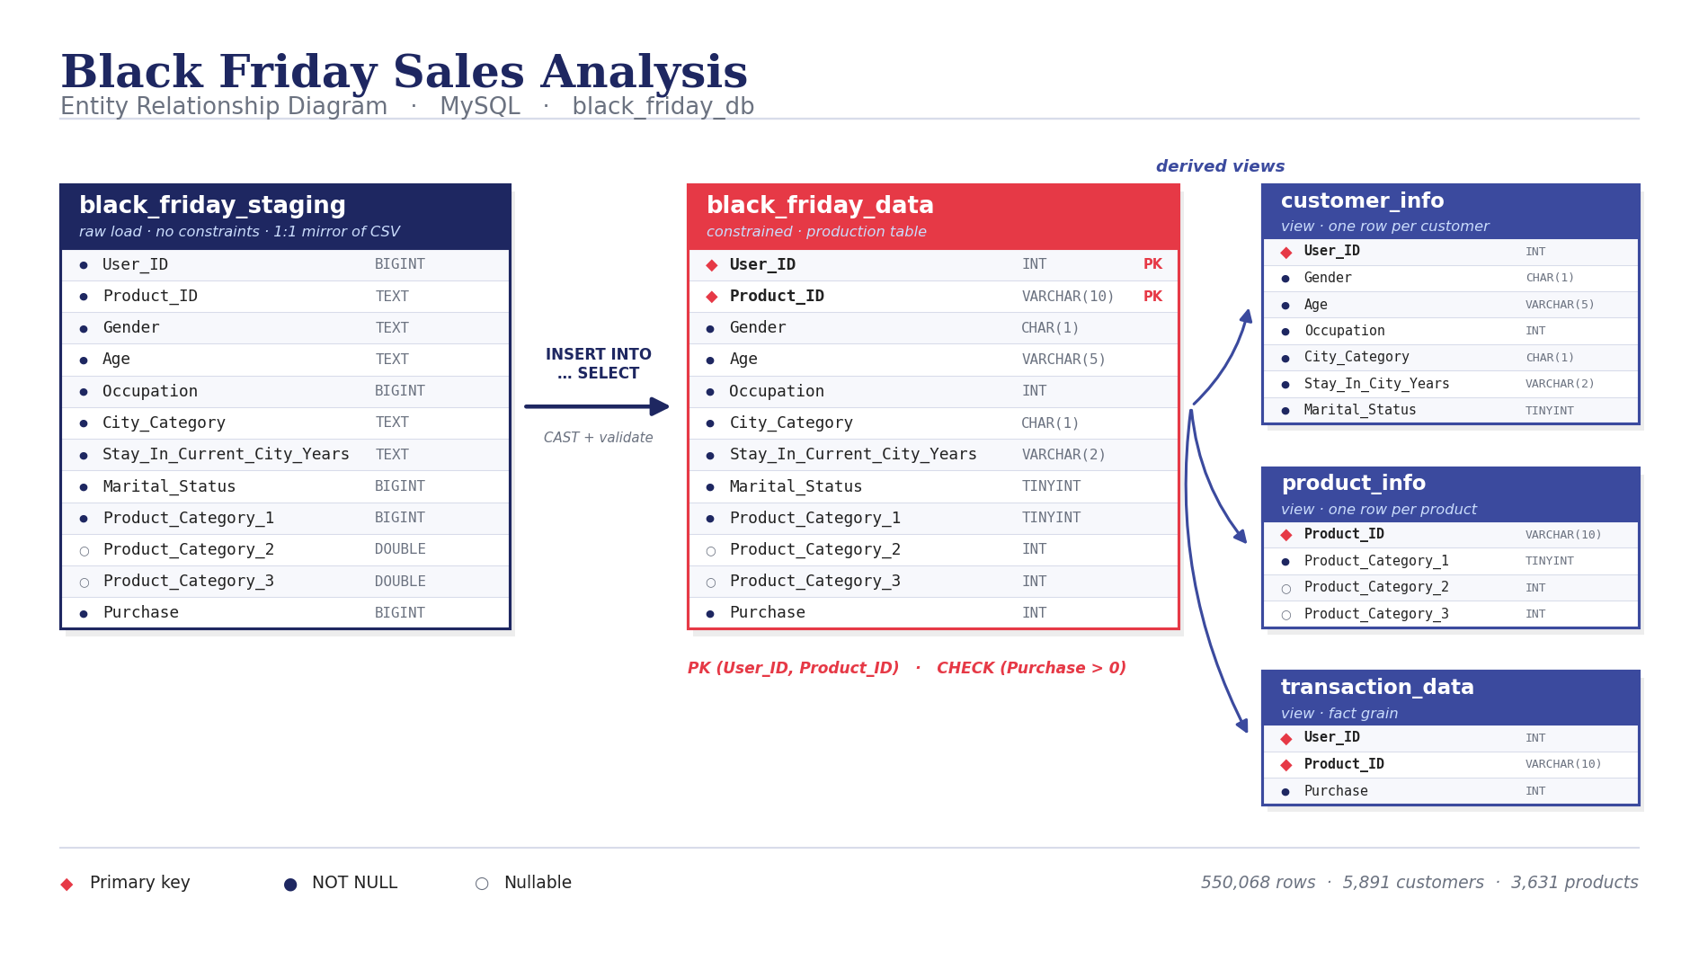
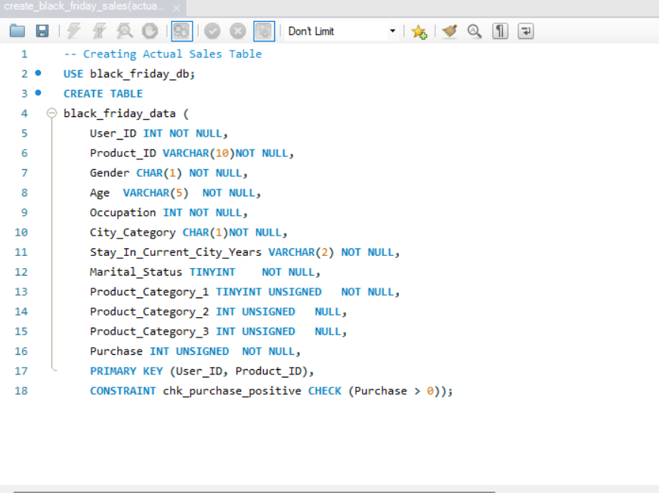
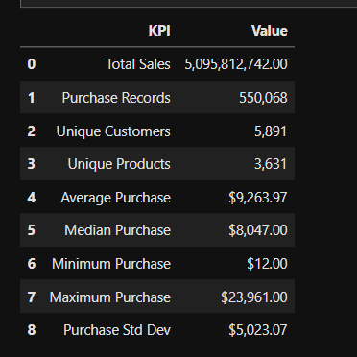
DATA FOUNDATION
From Raw CSV to a Validated Data Model
550,068
ROWS MIGRATED
0
DUPLICATE KEYS FOUND
0
NULLS IN REQUIRED FIELDS
₹5.10bn
TOTAL SALES VALIDATED
Staging → constrained table (PK, NOT NULL, CHECK Purchase > 0) → dimension views
BLACK FRIDAY SALES ANALYSIS — STAKEHOLDER REVIEW
04

Slide 5
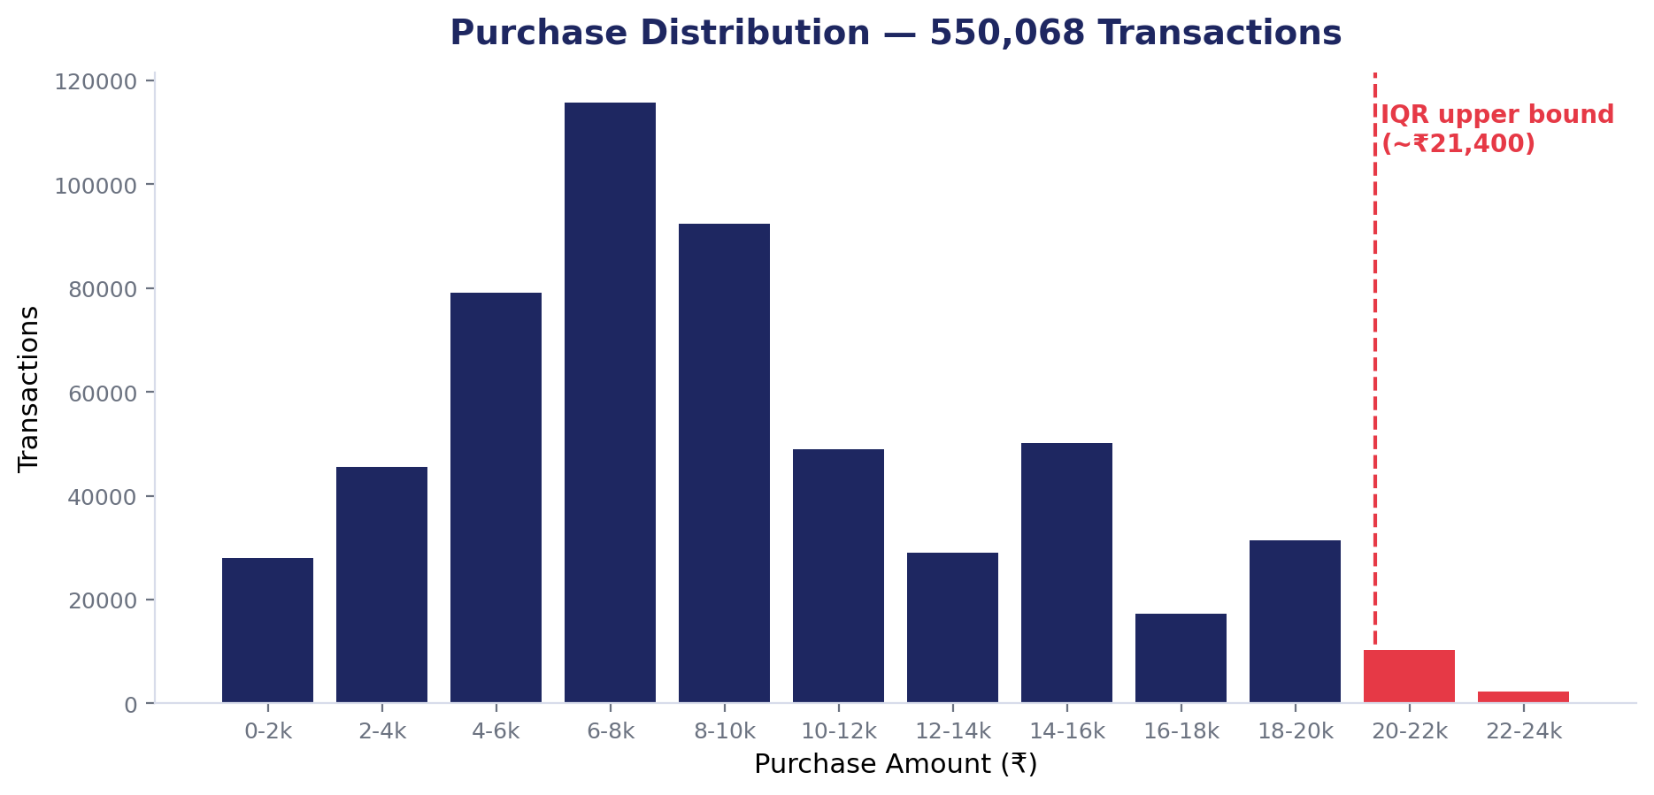
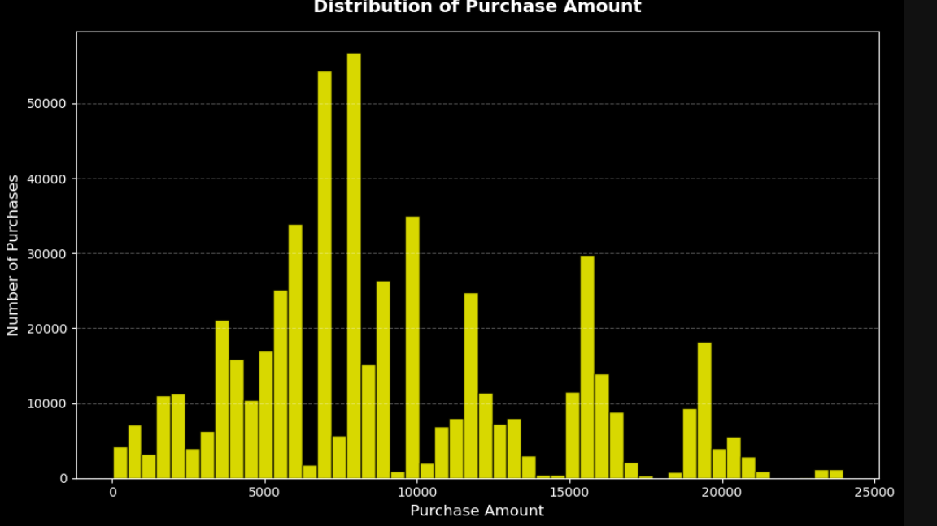
EXPLORATORY ANALYSIS
Outlier Validation — Flagged, Not Removed
0.49%
of transactions exceed the IQR upper bound of ₹21,400
0 rows
flagged by a z-score test (|z| > 3) : the distribution is right-skewed, not erratic
85% of flagged rows sit in a single premium category, where they make up 44% of its volume.
Verdict: category-driven pricing, not data error –retained and flagged as a high-value indicator.
Python (matplotlib) — raw distribution output
BLACK FRIDAY SALES ANALYSIS — STAKEHOLDER REVIEW
05

Slide 6
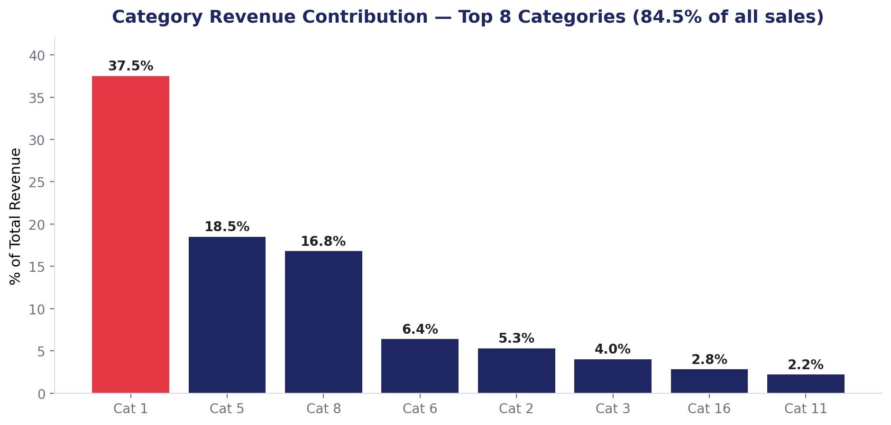
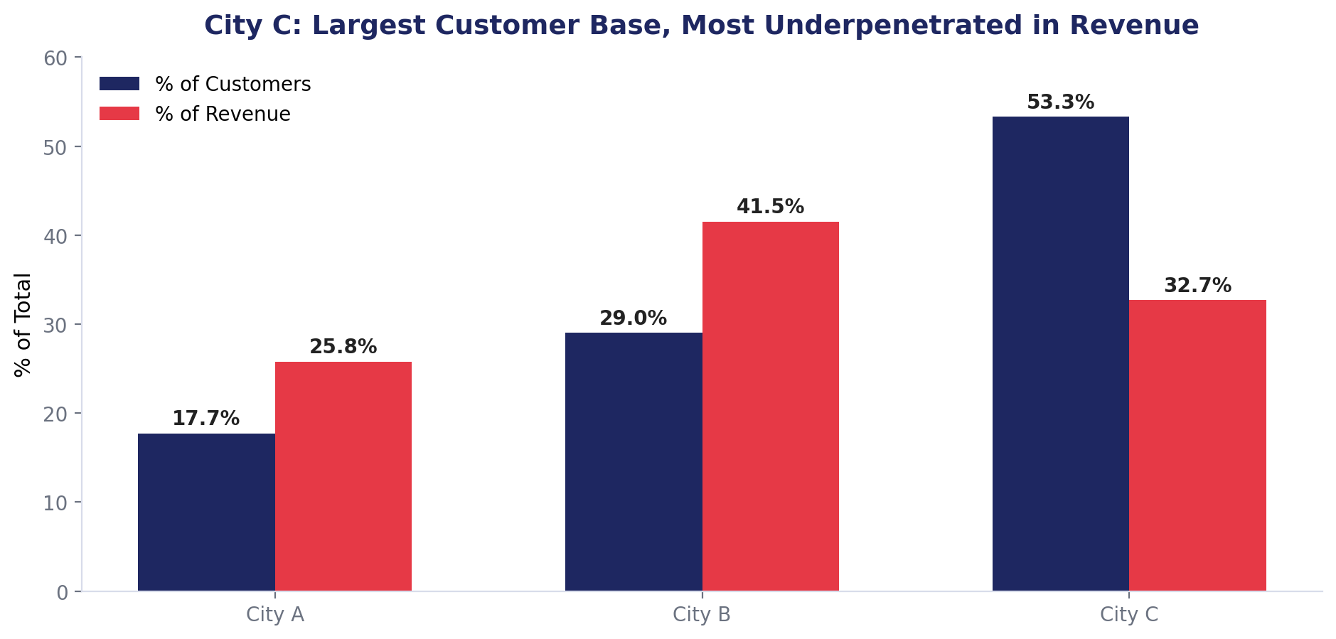
EXPLORATORY ANALYSIS
Category & Geographic Contribution
Concentrated portfolio
Volume ≠ value
The top 5 of 20 categories generate 84.5% of revenue. Inventory and promotional planning should weight accordingly.
City C holds the most customers but the least revenue per head which is the largest untapped opportunity in the business.
BLACK FRIDAY SALES ANALYSIS — STAKEHOLDER REVIEW
06

Slide 7
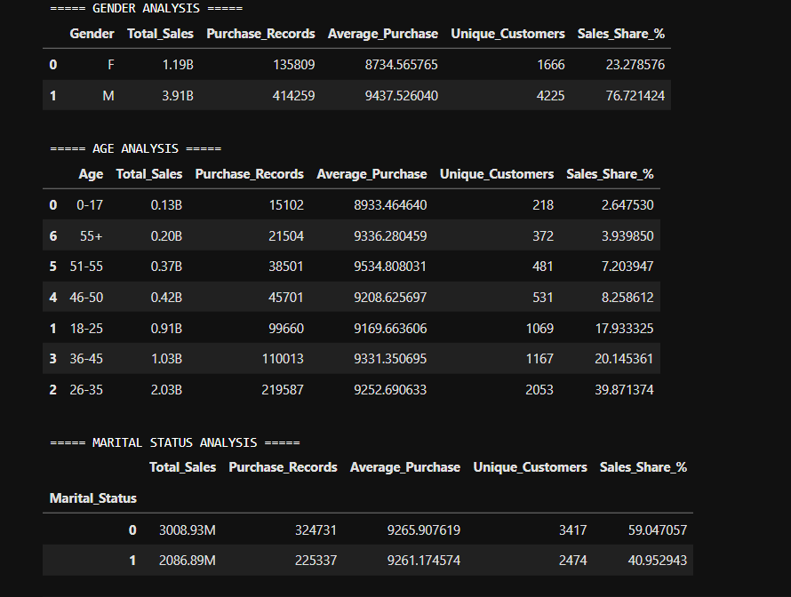
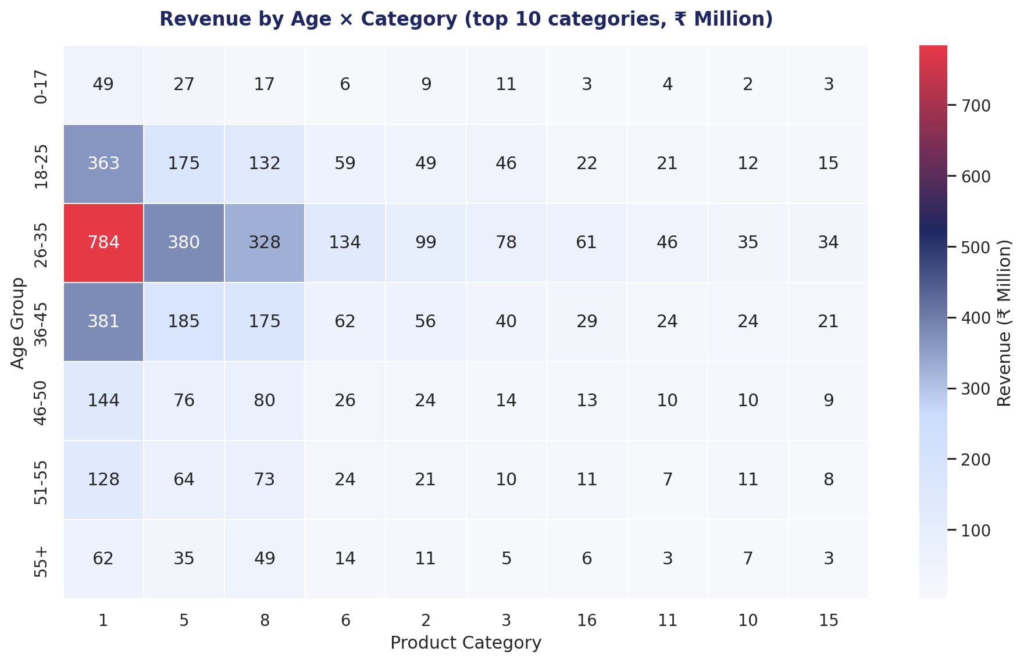
EXPLORATORY ANALYSIS
Demographic Deep-Dive
Gender · Age · Marital status breakdown (Python)
Age × Category revenue concentration
BLACK FRIDAY SALES ANALYSIS — STAKEHOLDER REVIEW
07

Slide 8
STATISTICAL VALIDATION
Hypothesis Testing — What Actually Holds Up
Business Question
Statistical Test
Result
Decision
Average purchase differs by Gender?
Welch's t-test
t = 16.49, p < 0.05
Reject H₀
Average purchase differs by Age?
One-way ANOVA
F = 5.05, p < 0.05
Reject H₀
Average purchase differs by City Category?
One-way ANOVA
F = 17.05, p < 0.05
Reject H₀
Category Breadth associated with Total Spend?
Pearson correlation
r = 0.734
Reject H₀
City Tenure associated with Avg Purchase?
Spearman correlation
corr = 0.017, p = 0.1925
Fail to Reject H₀
Average purchase differs by Occupation?
One-way ANOVA
F = 7.50, p < 0.05
Reject H₀
Takeaway: Gender, age, city, and occupation all show significant differences in purchase value where each is usable for segmentation. City tenure does not (p = 0.1925), so it should be excluded from targeting logic. Significant ANOVA identifies that groups differ, not which ones for that post-hoc testing required.
BLACK FRIDAY SALES ANALYSIS — STAKEHOLDER REVIEW
08

Slide 9
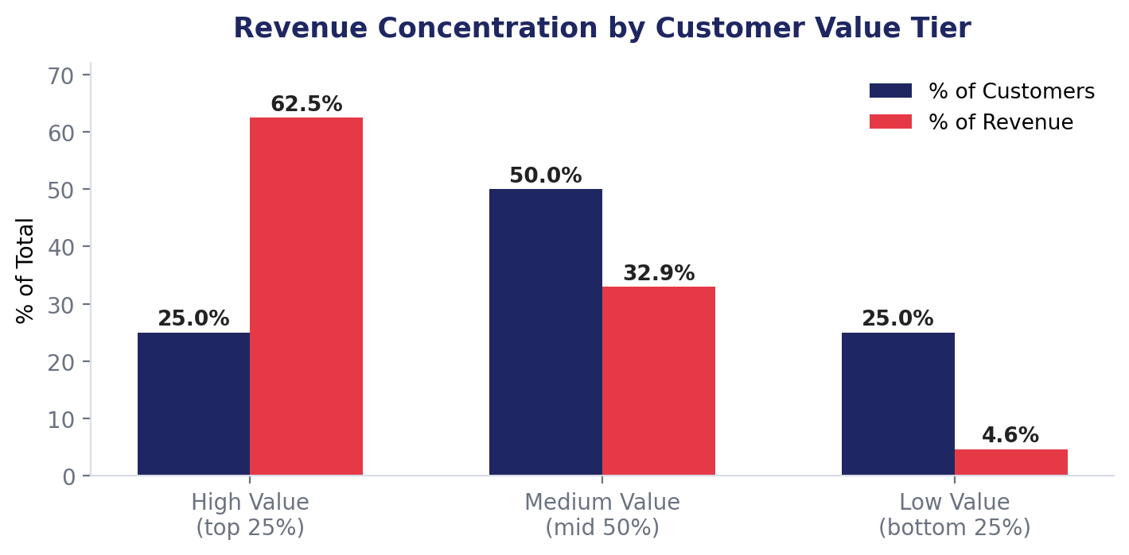
CUSTOMER SEGMENTATION
Revenue Is Concentrated in a Small Segment
62.46%
of total revenue comes from just the top 25% of customers by spend
Retaining this segment protects the majority of the business — it is the single highest-leverage group in the dataset.
BLACK FRIDAY SALES ANALYSIS — STAKEHOLDER REVIEW
09

Slide 10
CUSTOMER SEGMENTATION
Category Breadth Is the Strongest Behavioral Driver
r = 0.734
13.8
6.3
Correlation between category breadth and total spend
Average categories purchased by High-Value customers
Average categories purchased by Low-Value customers
Unlike demographic traits, category breadth is directly actionable therefore bundling and cross-sell recommendations can move a customer up-tier.
BLACK FRIDAY SALES ANALYSIS — STAKEHOLDER REVIEW
10

Slide 11
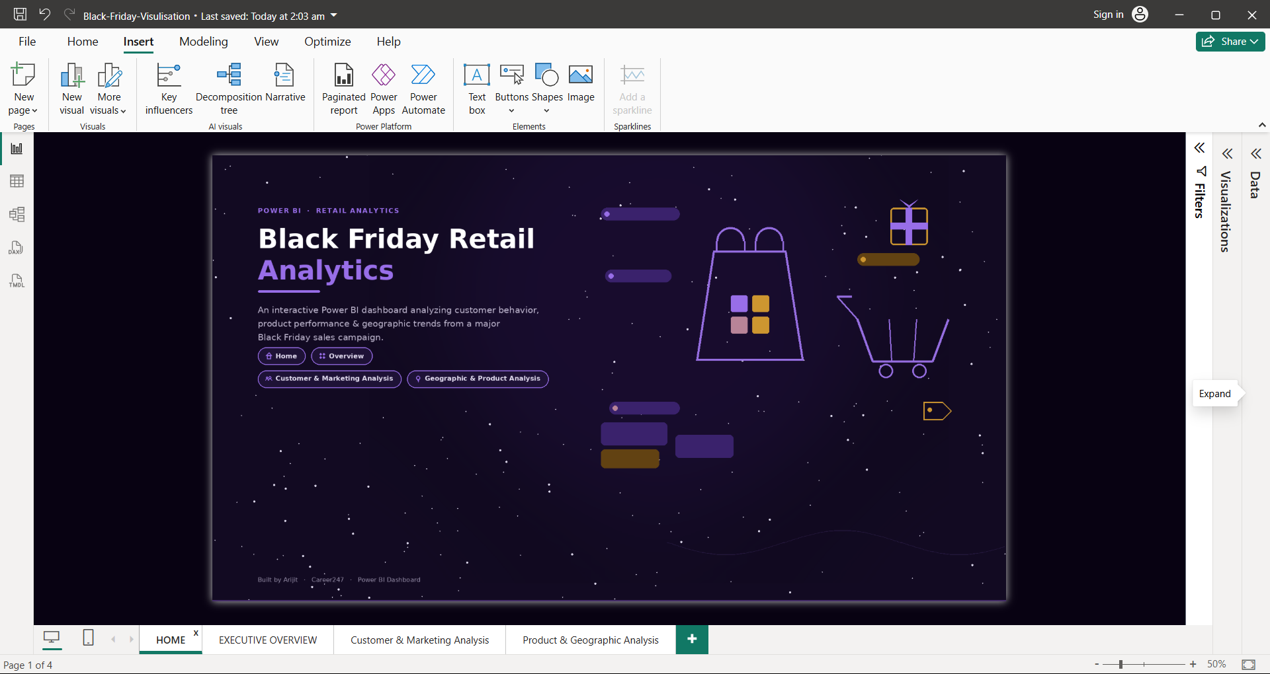
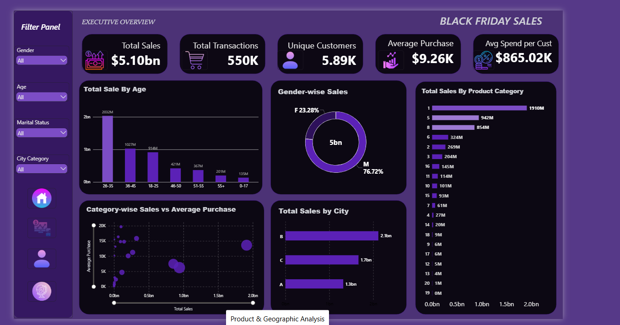
LIVE DASHBOARD
Power BI — Home & Executive Overview
Landing page with cross-page navigation
Executive Overview — KPIs, age, gender, category & city
All four pages share a common filter panel which are Gender, Age, Marital Status and City Category , so any finding in this deck can be re-sliced live during discussion.
BLACK FRIDAY SALES ANALYSIS — STAKEHOLDER REVIEW
11

Slide 12
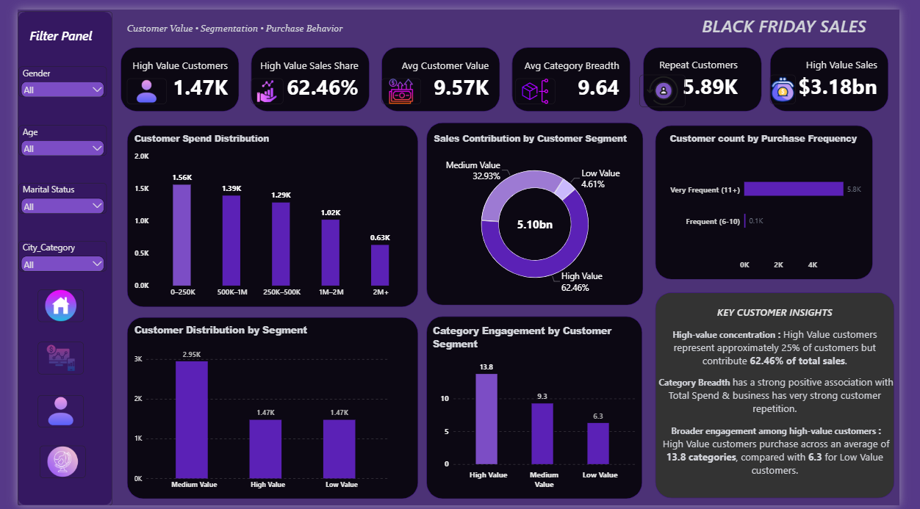
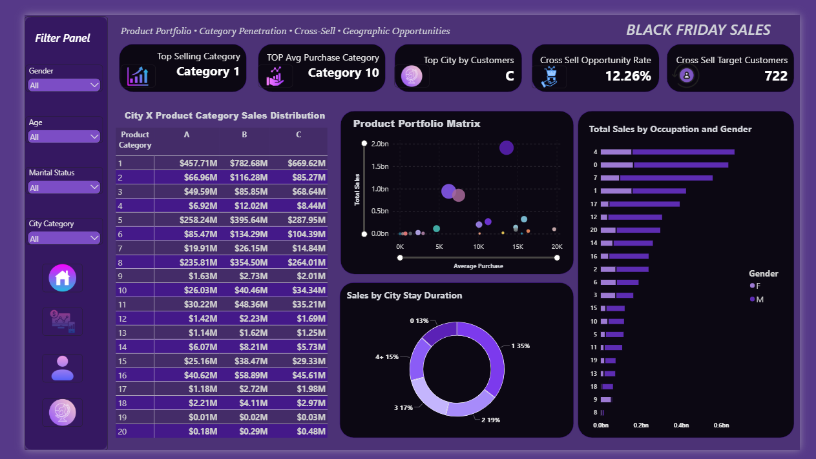
LIVE DASHBOARD
Power BI — Customer, Marketing & Product Views
Customer & Marketing — value tiers, spend distribution, breadth
Product & Geographic — portfolio matrix, city×category, cross-sell
Cross-sell opportunity rate of 12.26% identifies 722 target customers therefore a directly actionable campaign list, not just a descriptive metric.
BLACK FRIDAY SALES ANALYSIS — STAKEHOLDER REVIEW
12

Slide 13





KEY FINDINGS
Top 5 Insights
Revenue is concentrated in a small High-Value segment.
Top 25% of customers generate 62.46% of revenue.
Sales are concentrated in a handful of categories.
Category 1 alone drives 37.5%; top 5 categories = 84.5% of sales.
City C is the largest but most underpenetrated market.
53.3% of customers, only 32.7% of revenue.
Category breadth is the strongest driver of customer value.
r = 0.734; High-Value customers span 13.8 categories vs. 6.3.
The core customer base is demographically concentrated.
Male = 76.72% of revenue; Age 26–35 = 39.9% of revenue.
BLACK FRIDAY SALES ANALYSIS — STAKEHOLDER REVIEW
13

Slide 14
STRATEGY
Strategic Recommendations
01
02
03
High-Value Retention
City C Activation
Category-Breadth Cross-Sell
Loyalty program for the top 25% of customers
Frequency-focused campaign, not discount-led
Bundle recommendations using r = 0.734 signal
EXPECTED IMPACT
EXPECTED IMPACT
EXPECTED IMPACT
62.46% of revenue protected
Largest headroom in the business
Directly moves customers up-tier
BLACK FRIDAY SALES ANALYSIS — STAKEHOLDER REVIEW
14

Slide 15
Thank You
Questions & Discussion
Full methodology, SQL scripts, notebooks, and the live dashboard are available in the project repository.
Prepared by Arijit · Career247 Data Analytics with GenAI Capstone

